Slide 1
GeoData WS2021/22 Group D
Adiel Batson, 28067 Daphne Larose, 27571 Kshama Gauri, 27628

Slide 2
Task 1.1 and 1.3
Mean Annual Temperature VS Altitudes
Dataframe Fixing & Graphs Plotting.ipynb
gdms0180_DWD_NRW_Annual_Temp_vs_Altitude.pynb

Slide 3
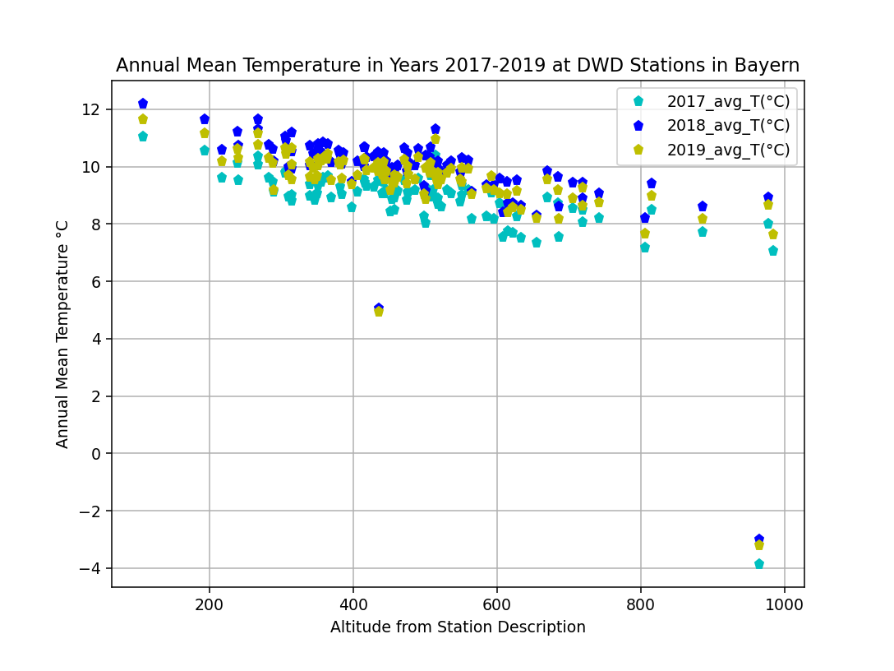
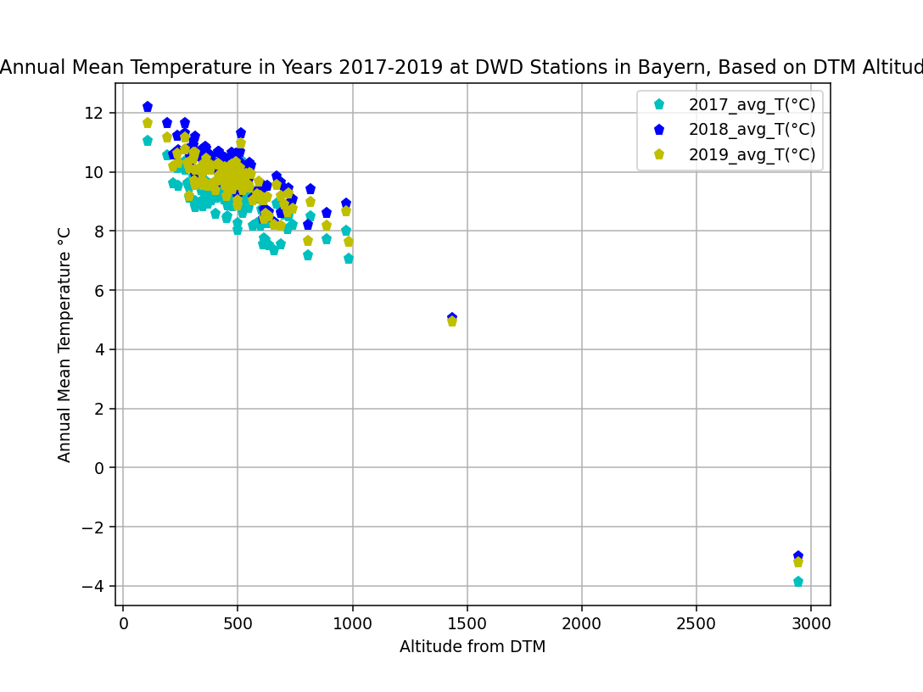
1. 1 Correlation of Mean Annual Temperature with Altitude in Bavaria
.
Fig.1 Annual Mean Temperature Vs DWD Stations’ Altitudes in Bayern, between 2017 & 2019.
Fig.2 Annual Mean Temperature Vs Sampled DTM altitudes at DWD Stations in Bayern, between 2017 & 2019.

Slide 4
Findings…
Trend 1: Temperature decreases with increases altitude. Zugspitze (the highest station altitude) has the coldest mean annual temperature.
Trend 2: The DTM altitudes vary from the the station altitudes. Greater variance occurs at stations with greater altitude.
within first 1000m of altitude the deviations are minimal.
at altitudes >1000m deviations increase drastically.

Slide 5
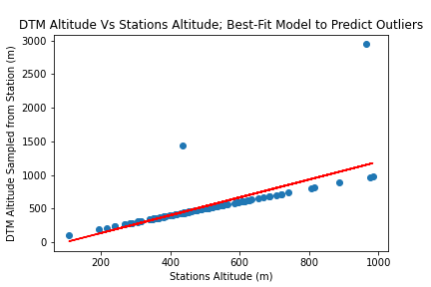
.
Greatest Outliers:
Großer Arber
Zugspitze
Fig. 3 Best Fit Line Between DWD Station Altitudes and DTM Altitudes Sampled at DWD Stations.

Slide 6
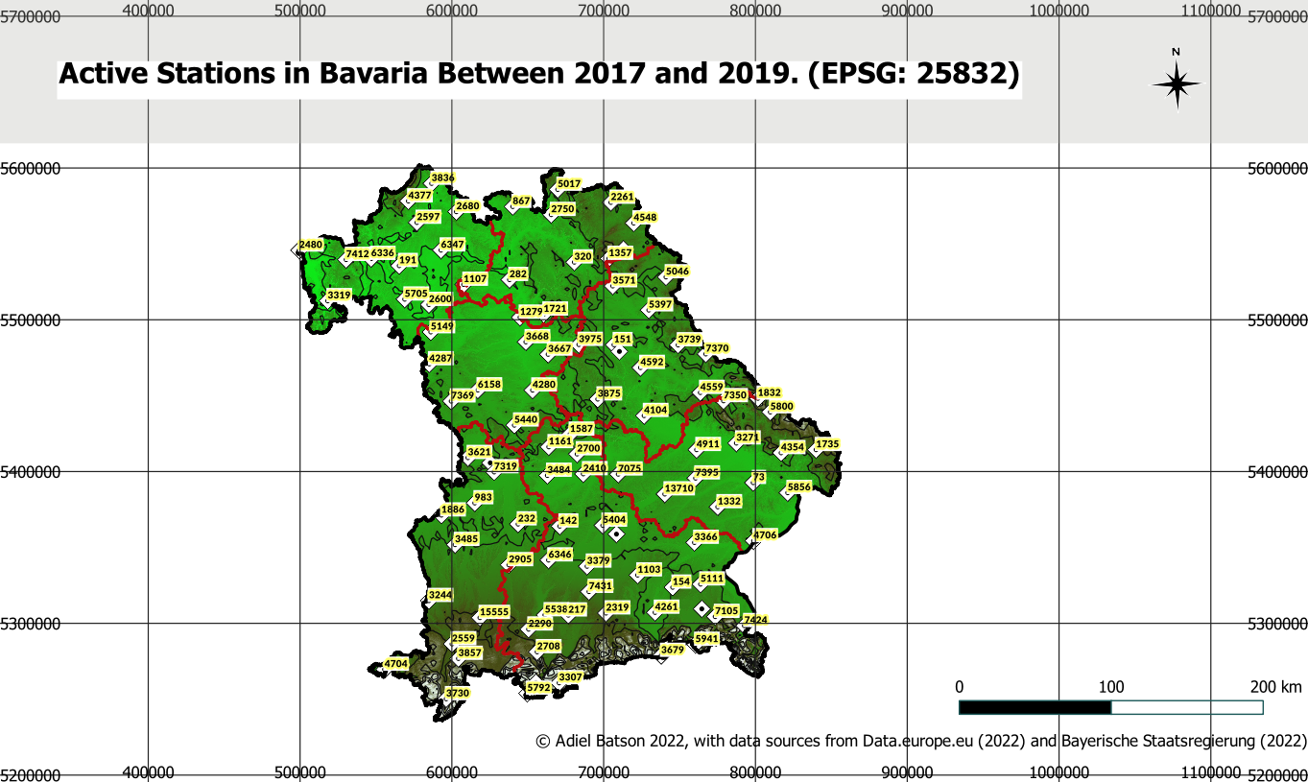
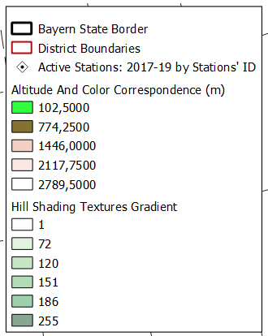

Slide 7
Process Outline Subtask 1.2
Bayern was added into QGIS from Bayerische Staatsregierung (2022) as a vector layer of the state of bayern and a vector layer of the administrative borders in the state (shape files located in Git folder All Data Files).
The file ts_appended.csv was added to QGIS and the stations were marked, annotated by their station numbers and recolored. They symbols were also selected.
Both DTMs were cropped precisely to the Bayern border vector layer Bayern State Border and color corrected as follows to a new layer called Altitude And Color Correspondence:
green = low lands <700m altitude
brown = mountainous areas >700m> 1400m altitude
white = The Alpine peaks >1400m altitude

Slide 8
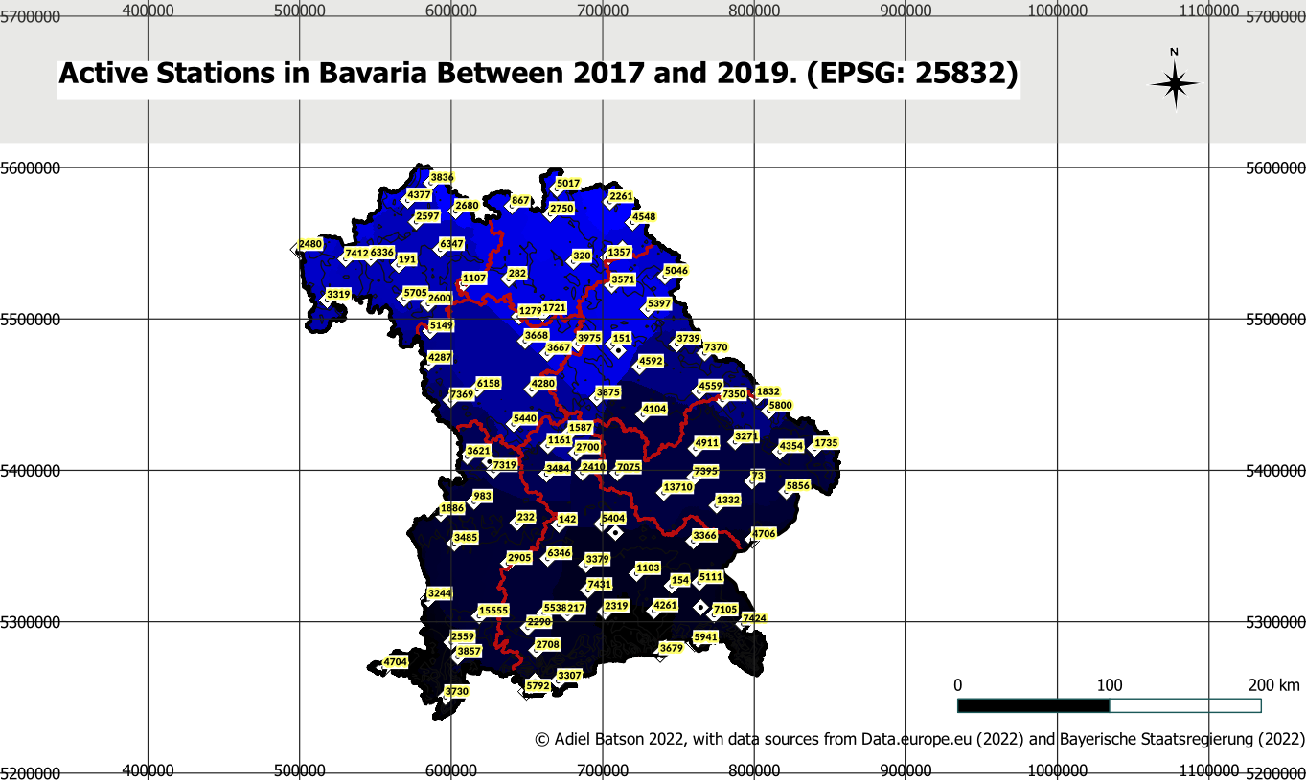
Primary Watershed Areas In Bavaria
Legend:
Darker shades represent areas where water drainage across the topography occurs fastest.
Therefore, lighter shades not only correspond to lower water drainage speeds, but simultaneously more homogenous topological features!

Slide 9
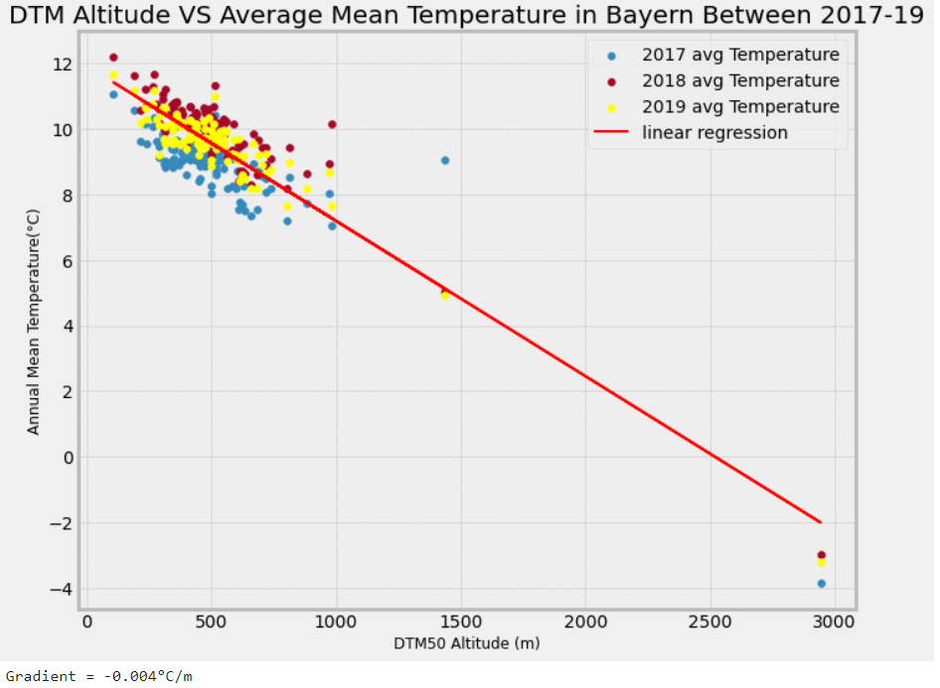
Linear R
Linear Regression
Termperature variance with height = -0.004 °C/m

Slide 10
2. DWD Precipitation Measurements in NRW: Create Movie with QGIS Temporal (Daphne Larose)
Open source tools were:
1. QGIS
2. Python(pandas, SQLalchemy)
3. PostgreSQl
4. PostGIS

Slide 11
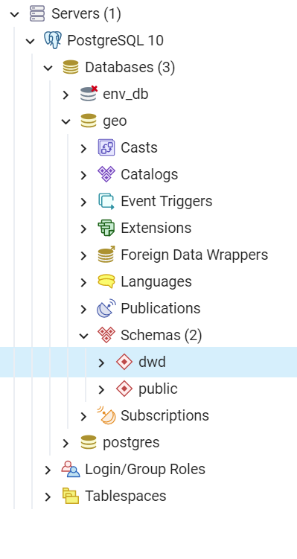
2.1 Create and fill your own geodatabase
The role “geo_master” and
the database “geo” were created.

Slide 12
2.1 Create and fill your own geodatabase
Using open data source DWD to get the recent hourly precipitation for North Rhine-Westphalia.
The DWD stations information were added to the database using geopandas.
The time series for the hourly precipitation were added using pandas.

Slide 13
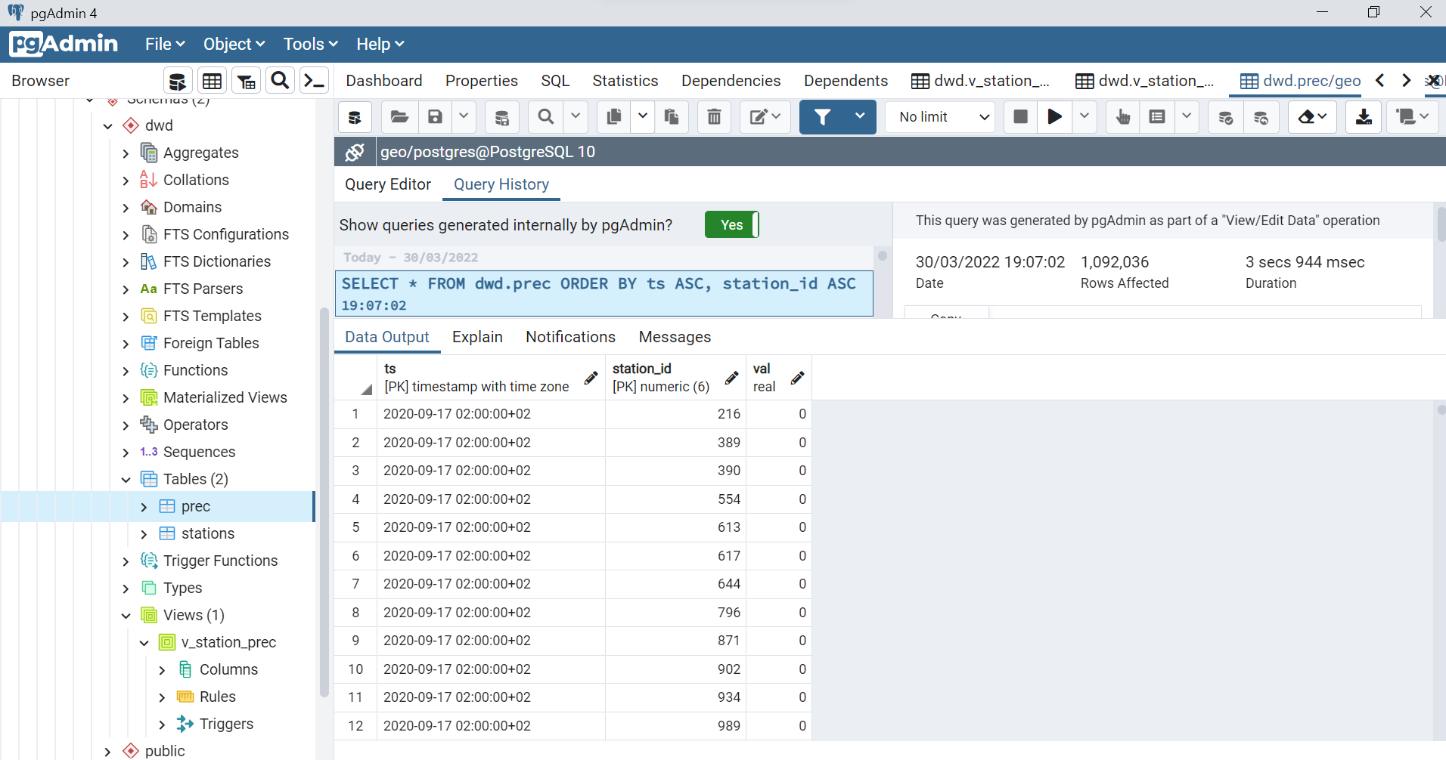
2.1 Create and fill your own geodatabase

Slide 14
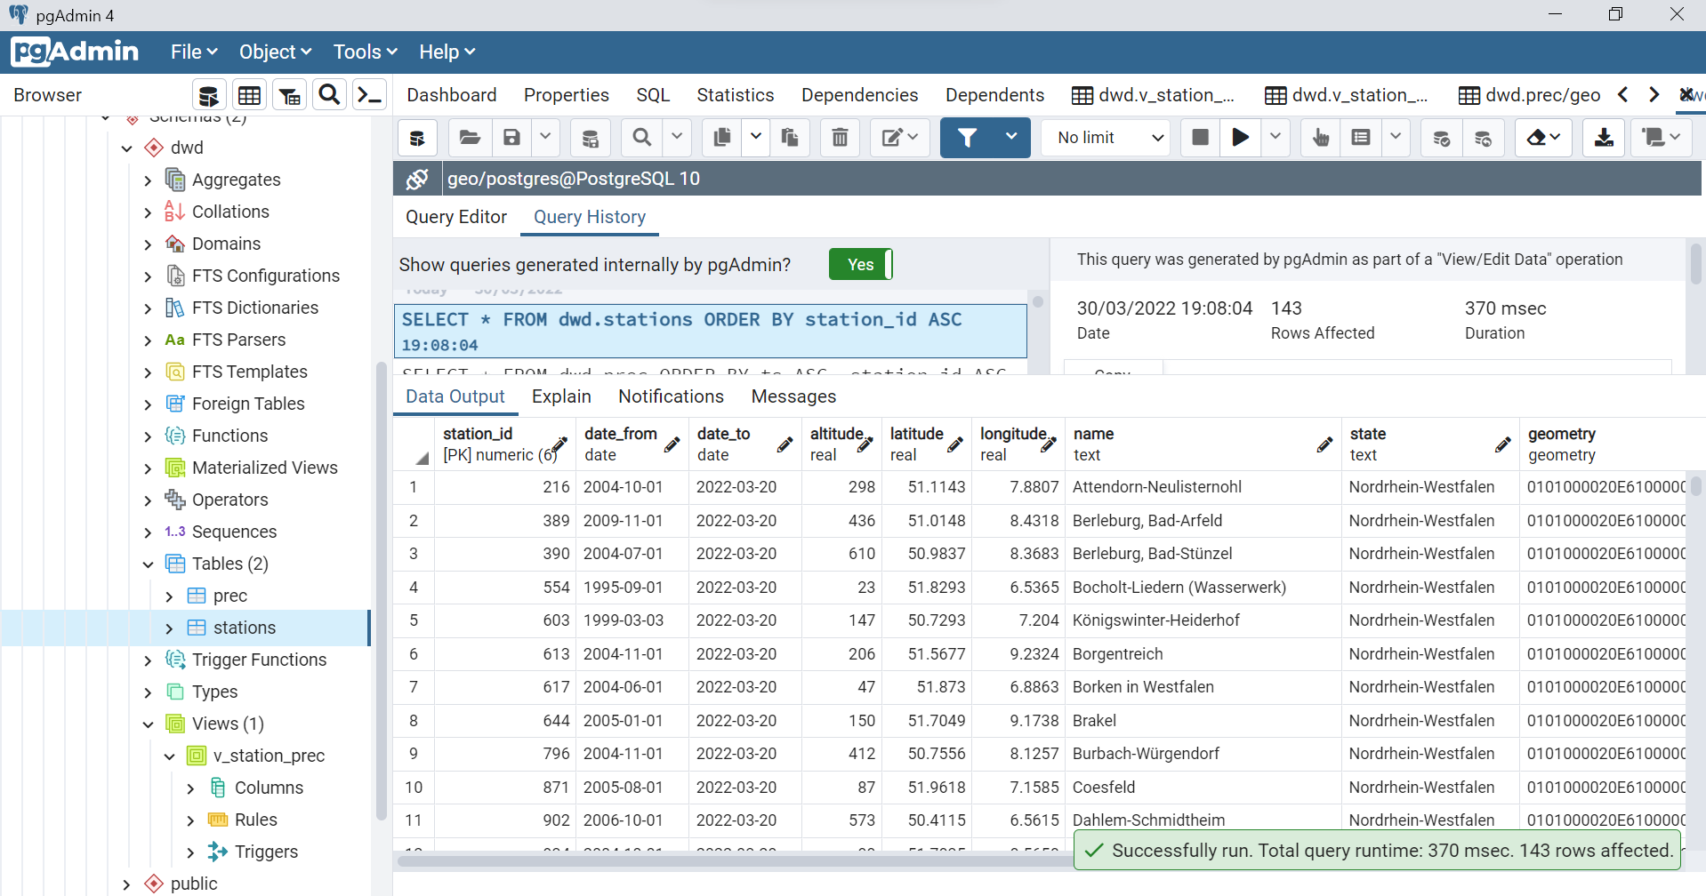
2.1 Create and fill your own geodatabase

Slide 15
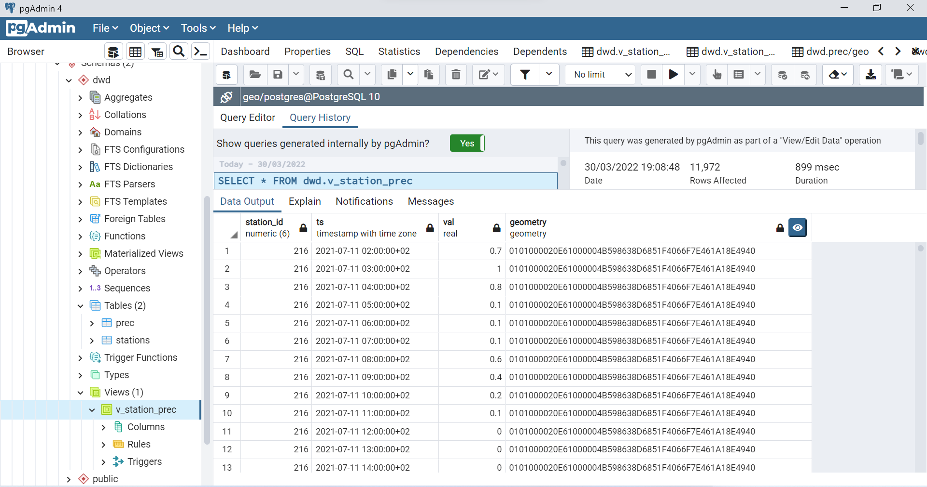
2.2: Add the PostGIS view v_stations_prec as a layer to your QGIS project

Slide 16
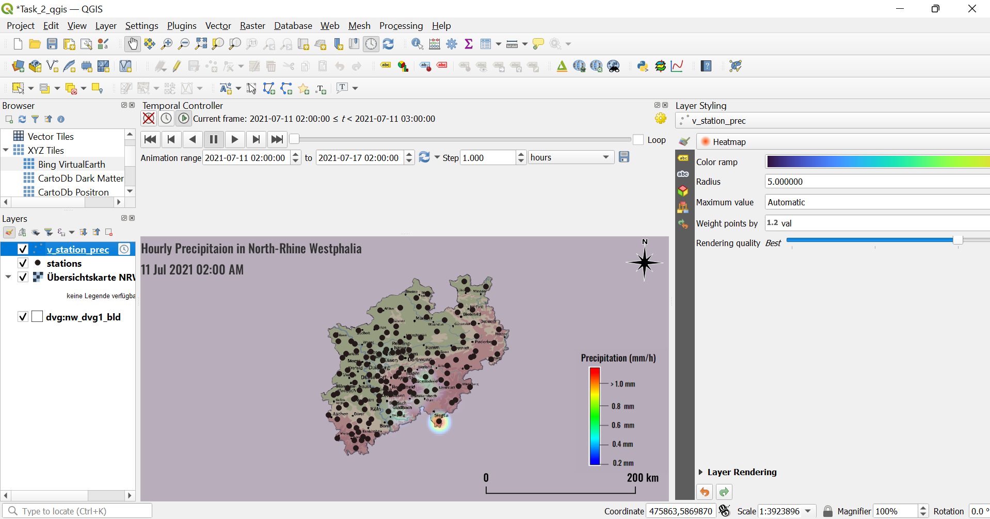
2.3 Use the QGIS Temporal Controller to produce an animation

Slide 17
2.3 Use the QGIS Temporal Controller to produce an animation

Slide 18
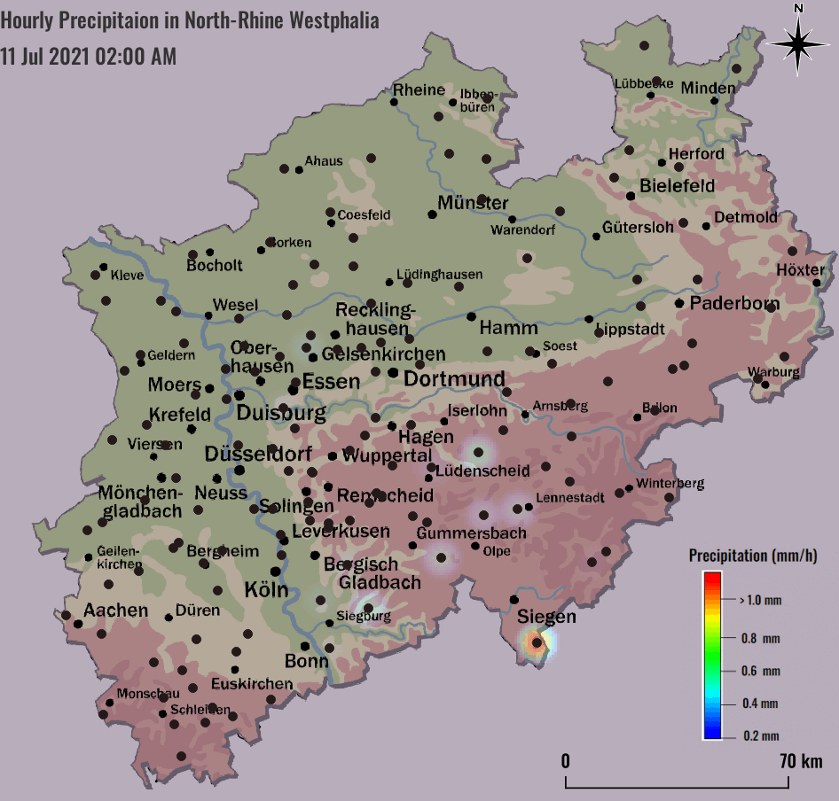
2.3 Use the QGIS Temporal Controller to produce an animation

Slide 19
3. Digitization: Burial Mounds in Uedemer Hochwald
By Kshama Gauri(27628)
Georeference a picture of a map of the burial mounds onto a DTK or topographic map of NRW by using various references provided in the DTK10 map.
Create a hillshade model of the DTM provided.
Calculate the elevation of the mound relative to the ground
Digitize an area of the map and save it as a geopackage.

Slide 20
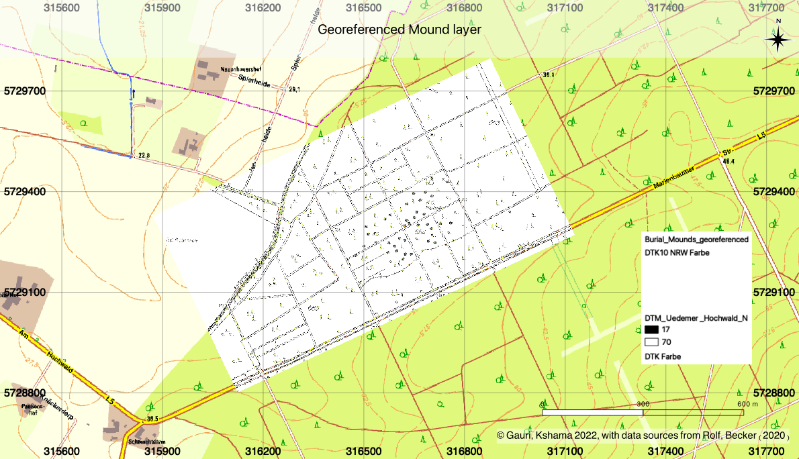
3.1 Subtask: Georeferencing picture of burial mounds
gdms0000_Burial_Mounds_Uedem_V001.qgz
Saved as Task3.1_Georeferenced_Mound_v001.qgz

Slide 21
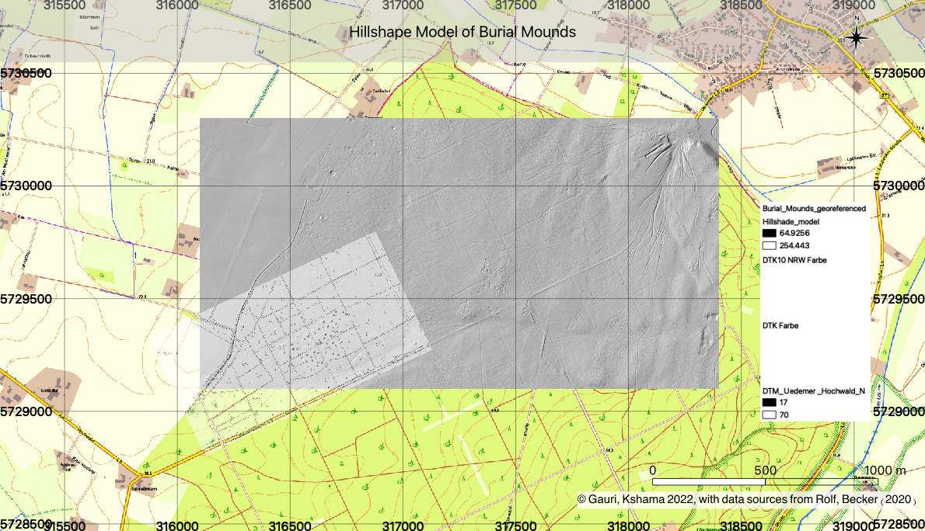
3.2 Subtask: Creation of hillshade model
Saved as Task3.2_Hillshape_model.qgz

Slide 22
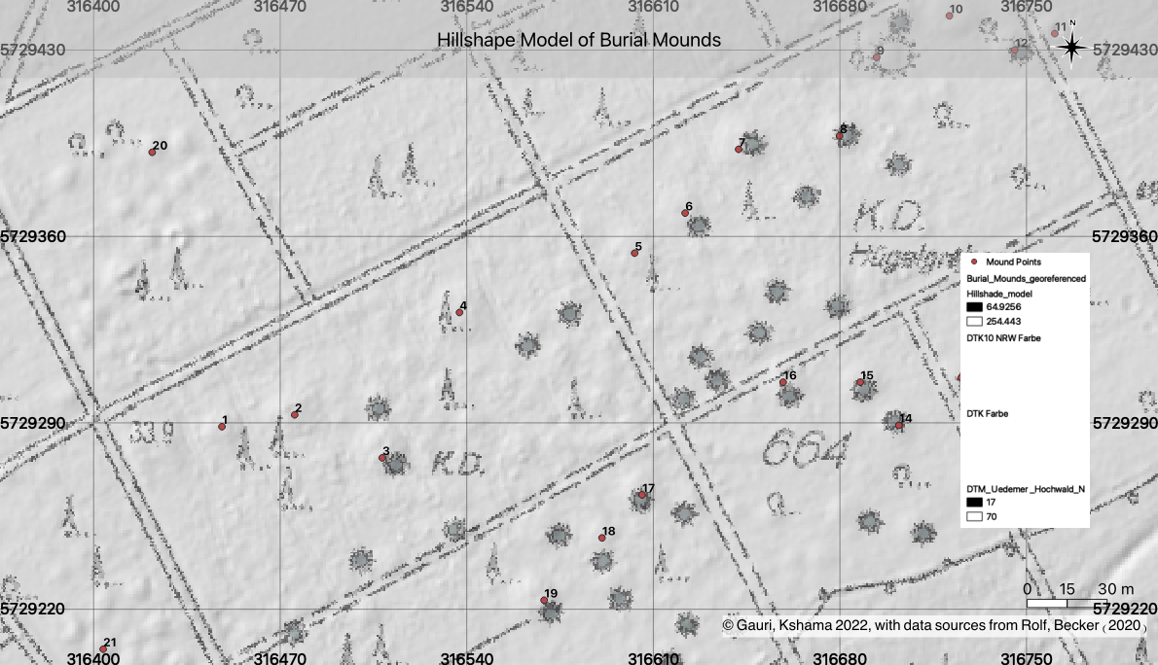
3.2 Subtask:Comparison of Hillshade model and image map
Point 3 difference = 5.8m
Point 8 difference = 8m

Slide 23
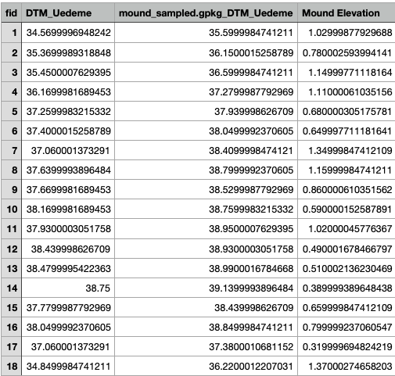
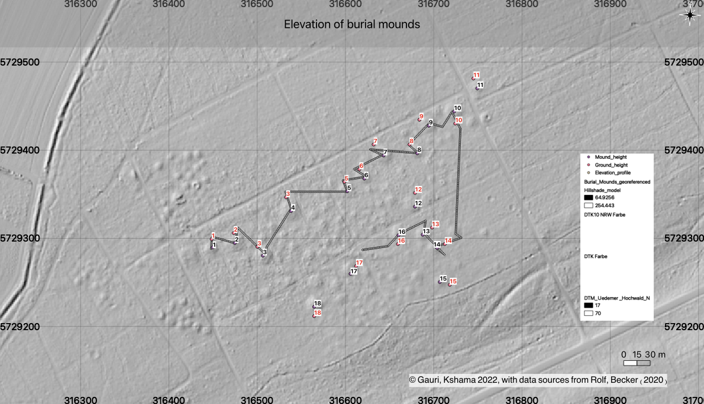
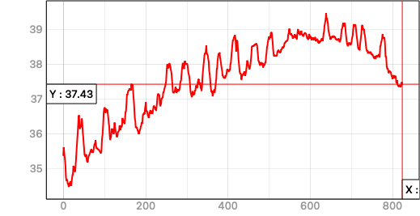
3.3 Subtask: Elevation of Mound
Mound elevation using point sampling tool
Saved as Task3.3_Elevation.qgz
Elevation profile done using profile tool

Slide 24
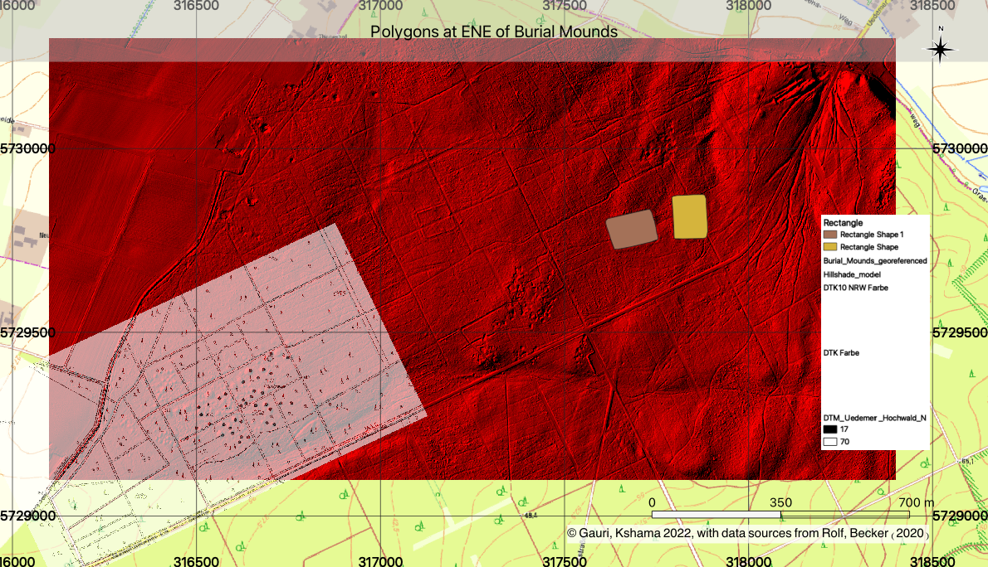
3.4 Digitization of rectangular structures
Saved as Task3.4_ENE_Burial_mounds.qgz

Slide 25
Findings of Task 3
Uedemer Hochwald is a region in the Kleve district. The south west part of the region serves as a nature reserve meanwhile the western is historically a burial mound.
The forest in the western part was cleared during the second world war. The digitized polygons could represent what is left of the camps from battle.

Slide 26
Task 4
Creation of 3d Model

Slide 27
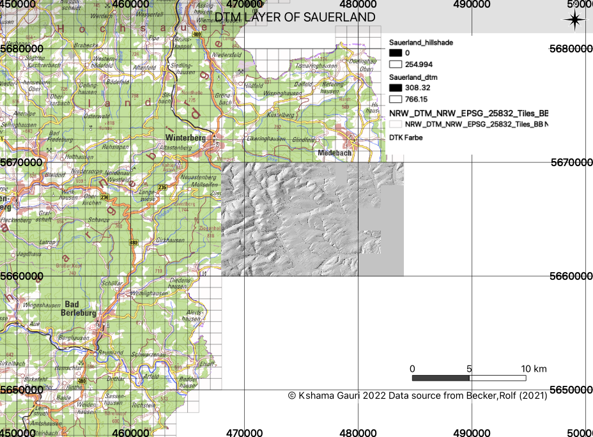
Subtask 4.1 Creation of DTM layer (Kshama Gauri)

Slide 28
Task 4: Subtask 4.2: (Adiel Batson)
Kshama’s generated .tif file and Sauerland DTM layer was imported as a raster layer.
A duplicate was then made to display:
Hillshade rendering (topographical texture)
Sauerland DTM colorized to show lower green lands, mountain brown lands
A shapefile for the waterways of the region of the DTM was used.

Slide 29
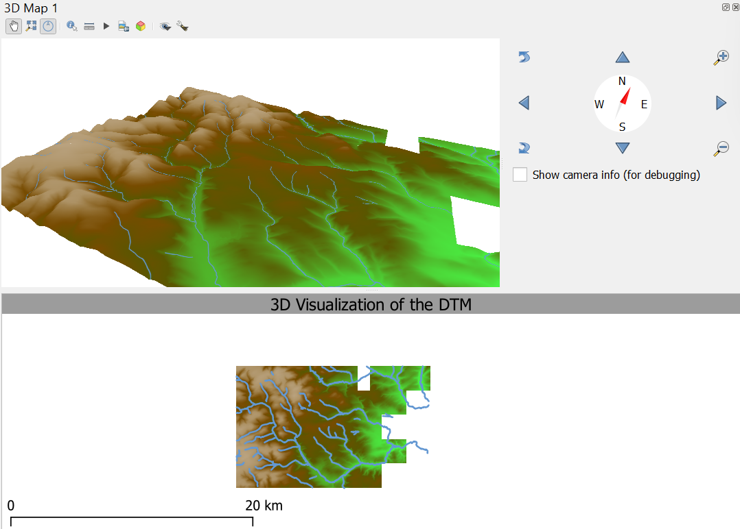
Subtask 4.2

Slide 30
Subtask 4.2 ( Daphne Larose)
Using python console, a series of XYZ tiles was imported to overlay the DTM.
A 3D model was then designed with the goal of making the map more realistic looking, using texture satellite image and the parameters were adjusted.
An animation of the new 3D map was created.

Slide 31
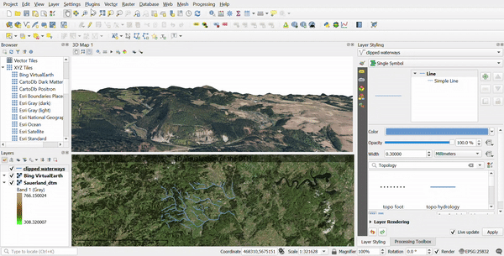
Subtask 4.2: 2D and 3D views side by side

Slide 32
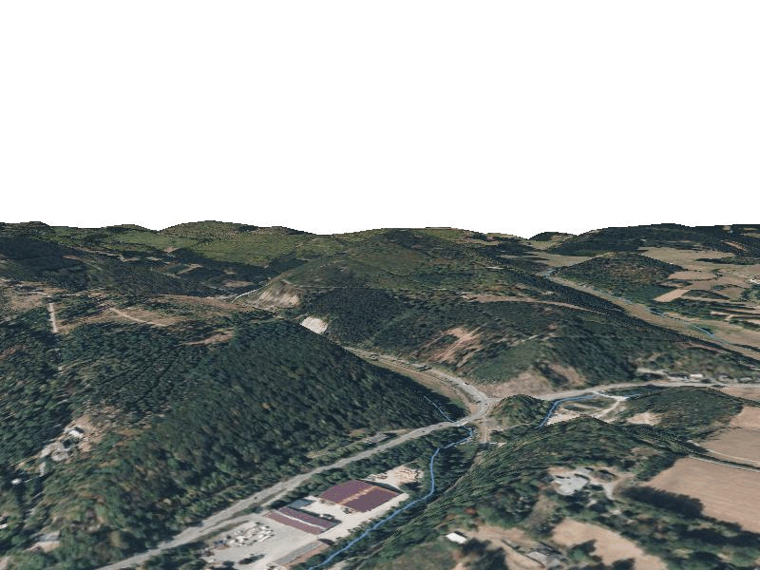
Subtask 4.2: Final Results

Slide 33
Kshama Gauri, 27628: Self-Assessment, Part 1
What is your role in the group?
Task 3: Digitization of Burial Mounds in Uedemer
Creation of dtm layer for task 4.
Which (sub)tasks are you responsible for?
Subtask 3.1-3.4 and subtask 4.1
With whom have you been cooperating?
Adiel, Daphne

Slide 34
Kshama Gauri, 27628: Self-Assessment, Part 2 (On a scale from 1 (poor) to 5 (very good))
What is your personal knowledge gain?
4
How do you rate your commitment?
4
How difficult is your task?
3.5

Slide 35
Kshama Gauri, 27628: Your Personal View
Biggest challenges?
Calculating the elevation for the mound relative to the ground.
Lessons learned?
QGIS provides powerful tools that make it easier to calculate this.
Whatever you want to say related to course, …
I find it interesting that qgis allows me to work on any location in the world remotely. It is quite cool that an in depth analysis of the environment and location can be made with such a program and collaboration of work from satellites and people over the world.

Slide 36
Daphne Larose, 27571: Self-Assessment, Part 1
What is your role in the group?
Task 2 and Task 4
Which (sub)tasks are you responsible for?
Video, Presentation, Subtask 4.2
With whom have you been cooperating?
Adiel Batson and Kshama Gauri

Slide 37
Daphne Larose, 27571: Self-Assessment, Part 2 (On a scale from 1 (poor) to 5 (very good))
What is your personal knowledge gain?
4
How do you rate your commitment?
4.5
How difficult is your task?
3.5

Slide 38
Daphne Larose, 27571: Your Personal View
What were the biggest challenges?
Coming up with our own ideas; there was countless of possible ideas but not enough time and also sometimes not enough information online to solve the errors we faced
Lessons learned?
Proper time management and organization
Whatever you want to say related to course
It was a nice mix of programming and QGIS which made the course more interesting. Learning about the different features and plugins available in QGIS and how we can handle all the spatial data was new and inspiring.

Slide 39
Adiel Batson, 28067: Self-Assessment, Part 1
What is your role in the group?
Task 1.0, read.me format, github set-up
Which (sub)tasks are you responsible for?
Subtasks 1.1-1.4, ⅓ Task 4.0
With whom have you been cooperating?
Daphne Larose, Kshama Gauri

Slide 40
Adiel Batson,28067: Self-Assessment, Part 2 (On a scale from 1 (poor) to 5 (very good))
What is your personal knowledge gain?
5
How do you rate your commitment?
5
How difficult is your task?
4.99

Slide 41
Adiel Batson, 28067: Your Personal View
Biggest challenges?
Plotting river channels and features. Organizing table headings with pandas, navigating the error messages with the linear regression
Lessons learned?
Manipulation of data, visualization using QGIS, customization and retrieving data.
Whatever you want to say related to course:
I liked the designing aspect of the assignment more than data manipulation. QGIS was nice in this sense, altogether quite nice; grateful to be able to better my skillset in this field.

